Slide 1
Sentiment Analysis for search result snippets
Nimesh Ghimire
19 | January | 2024

Slide 2
Outline
Introduction
Background
Research Objectives
Implementation
Backend
Frontend and Visualization
Methodology
Evaluation
Result and Analysis
Conclusion and Future Works

Slide 3
Outline
Introduction
Background
Research Objectives
Implementation
Backend
Frontend and Visualization
Methodology
Evaluation
Result and Analysis
Conclusion and Future Works

Slide 4
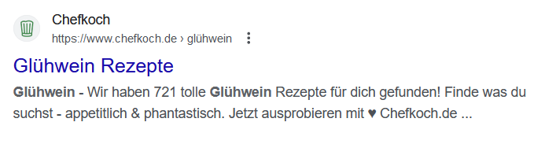
Introduction
Background
Search result snippets are short summaries of web pages that appear in search results.
URL
Title
Snippets
Source: www.google.com

Slide 5
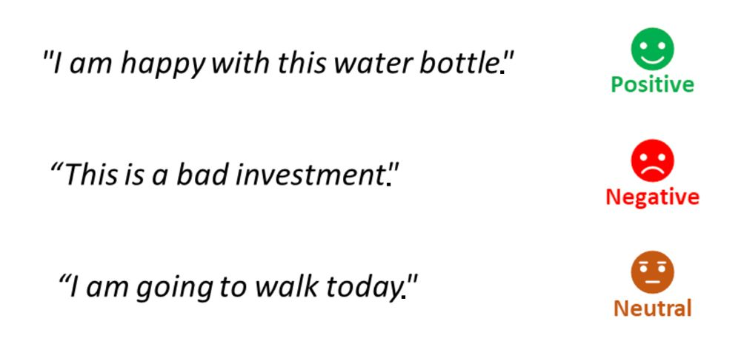
Introduction
Background
Sentiment analysis can simply be defined as the automatic process of extracting the emotional tone from the piece of text.

Slide 6
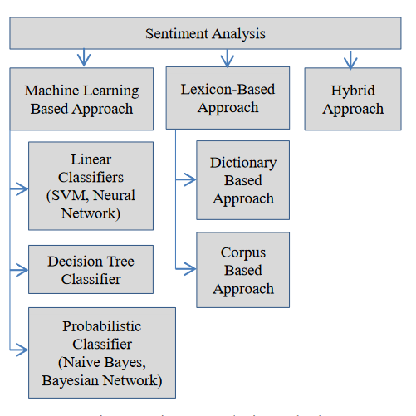
Introduction
Background
Sentiment analysis is mainly divided into three categories
Machine learning approach
Lexicon based approach
Hybrid approach ( machine learning and lexicon-based )
Challenges in Sentiment analysis
Sarcasm
“This food is good enough to waste money”
Multi domain
“cheap quality” and “cheap price”
Negation handling
“I like coffee” and “I do not like coffee”.
Multilingual text
Fig.01: Different types of sentiment analysis

Slide 7
Outline
Introduction
Background
Research Objectives
Implementation
Backend
Frontend and Visualization
Methodology
Evaluation
Result and Analysis
Conclusion and Future Works

Slide 8
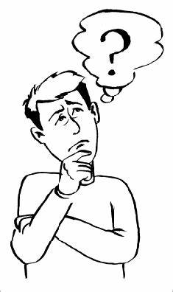
Introduction
Research Objectives
Why Sentiment Analysis for search result snippets ?
Source: https://clipart-library.com/

Slide 9
Introduction
Research Questions
Why Sentiment Analysis for search result snippets ?
Sentiment Variation of Result Snippets Across Search Engines
How the sentiment tone of result snippets from different search engines for same search query vary from each other?
Source: https://clipart-library.com/

Slide 10
Introduction
Research Questions
Why Sentiment Analysis for search result snippets ?
Sentiment Variation of Result Snippets Across Search Engines
Impact of Synonyms and Phrase Variations on Search Results Sentiment
Do search results sentiment differ with the use of synonyms or phrases?
Source: https://clipart-library.com/

Slide 11
Introduction
Research Questions
Why Sentiment Analysis for search result snippets ?
Sentiment Variation of Result Snippets Across Search Engines
Impact of Synonyms and Phrase Variations on Search Results Sentiment
Potential Discrimination in Search Engine Results
Do search engines unknowingly or privately support or discriminate on the basis of race, religion, ethnicity, geography, etc ?
Source: https://clipart-library.com/

Slide 12
Introduction
Research Questions
Why Sentiment Analysis for search result snippets ?
Sentiment Variation of Result Snippets Across Search Engines
Impact of Synonyms and Phrase Variations on Search Results Sentiment
Potential Discrimination in Search Engine Results
Sentiment Distribution for list of Queries and Positional Impact
What is the sentiment distribution for the query or set of (controversial) queries , how the distribution changes with further positions ?
Source: https://clipart-library.com/

Slide 13
Outline
Introduction
Background
Research Objectives
Implementation
Backend
Frontend and Visualization
Methodology
Evaluation
Result and Analysis
Conclusion and Future Works

Slide 14

Implementation
Backend
Django
Django is a high-level Python web framework that encourages rapid development and clean, pragmatic design.
Django Rest API
Beautiful Soup
NLTK
Source: https://www.djangoproject.com/

Slide 15

Implementation
Backend
Django
Django Rest API
Django REST framework is a powerful and flexible toolkit for building Web APIs.
It is built on top of the Django web framework and provides several features to create RESTful APIs.
Beautiful Soup
NLTK
Source: https://www.django-rest-framework.com/

Slide 16

Implementation
Backend
Django
Django Rest API
Beautiful Soup
Beautiful Soup is a powerful tool for web scraping and is user-friendly for beginners.
Beautiful Soup provides libraries to scrape information from web pages easily.
NLTK
Source: https://shorturl.at/gpt47

Slide 17

Implementation
Backend
Django
Django Rest API
Beautiful Soup
NLTK
The Natural Language Processing Toolkit (NLTK) is an open-source language processing module of human language in Python.
It provides lexical resources such as WordNet, text text-processing libraries for classification, tokenization, stemming, tagging, parsing, etc.
Source: https://shorturl.at/QTW07

Slide 18
Outline
Introduction
Background
Research Objectives
Implementation
Backend
Frontend and Visualization
Methodology
Evaluation
Result and Analysis
Conclusion and Future Works

Slide 19

Implementation
Frontend and Visualization
React js
React.js ( React), is one of the most popular JavaScript framework created by Facebook.
Used to create large web applications that use data and can change without reloading the page.
Recharts
Source: https://shorturl.at/kqtI0

Slide 20
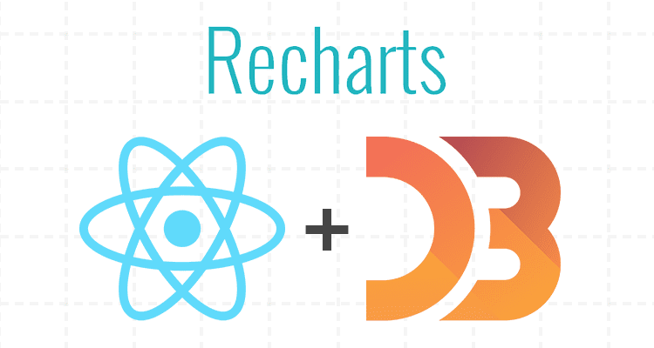
Implementation
Frontend and Visualization
React js
Recharts
Recharts is one of the best react visualization library.
Responsive charts, many different chart types, and features.
Based on D3.js
Source: https://shorturl.at/giIP7

Slide 21
Outline
Introduction
Background
Research Objectives
Implementation
Backend
Frontend and Visualization
Methodology
Evaluation
Result and Analysis
Conclusion and Future Works

Slide 22
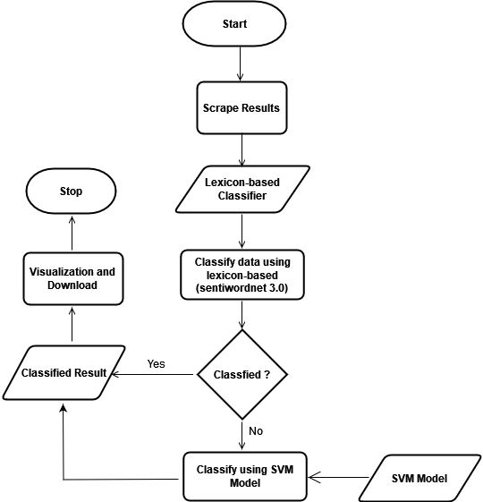
Methodology
Workflow of Hybrid approach of sentiment analysis
Hybrid approach combining lexicon-based and machine learning approach.
For lexicon-based, (sentiwordnet 3.0) dictionary-based approach is utilized.
Sentiwordnet is an opinion lexicon derived from Wordnet database.
SVM is used as a supervised machine learning approach.
Lexicon-based approach classifies the scraped snippets (negative, positive, or neutral).
If snippet cannot be classified by lexicon-based model, forward it to the SVM classifier.
Once classified, available for visualization and download.
Fig.01: Workflow of Hybrid approach

Slide 23
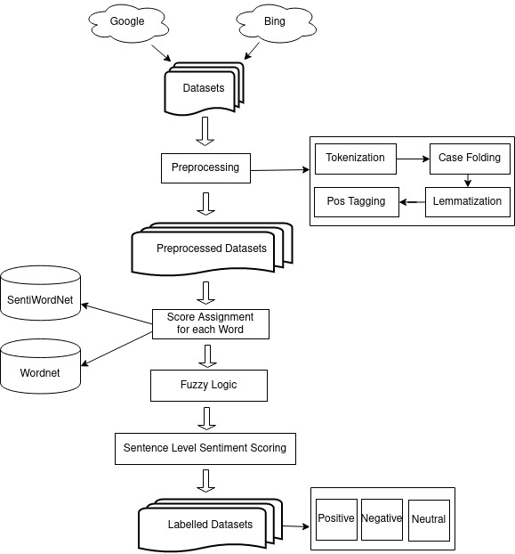
Methodology
Workflow of Lexicon based approach
Dataset from different search engines.
Pre-processing
Score Assignment for each word (Wordnet, SentiwordNet)
Fuzzy Logic
Sentence Level Scoring
Classified Snippets
Fig.02: Workflow of Lexicon based approach

Slide 24
Methodology
Preprocessing- Lexicon based approach
Example sentence : Thomas was gazing the Sunset delightfully.
Tokenization: [“Thomas", “was", “gazing", "the", “Sunset", “delightfully"]
Fig.02: Workflow of Lexicon based approach

Slide 25
Methodology
Preprocessing- Lexicon based approach
Example sentence : Thomas was gazing the Sunset delightfully.
Tokenization: [“Thomas", “was", “gazing", "the", “Sunset", “delightfully"]
Lowercasing: [“thomas", “was", “gazing", "the", “sunset", “delightfully“]
Fig.02: Workflow of Lexicon based approach

Slide 26
Methodology
Preprocessing- Lexicon based approach
Example sentence : Thomas was gazing the Sunset delightfully.
Tokenization: [“Thomas", “was", “gazing", "the", “Sunset", “delightfully"]
Lowercasing: [“thomas", “was", “gazing", "the", “sunset", “delightfully"]
Lemmatization: [“thomas", “was", “gaze", "the", “sunset", “delightful"]
Fig.02: Workflow of Lexicon based approach

Slide 27
Methodology
Preprocessing- Lexicon based approach
Example sentence : Thomas was gazing the Sunset delightfully.
Tokenization: [“Thomas", “was", “gazing", "the", “Sunset", “delightfully]
Lowercasing: [“thomas", “was", “gazing", "the", “sunset", “delightfully"]
Lemmatization: [“thomas", “was", “gaze", "the", “sunset", “delightful"]
Pos Tagging:
[
thomas – (NNP)
was – (VBD)
gaze – (VBG)
the – (DT)
sunset – (NN)
delightful – (JJ)
]
Fig.02: Workflow of Lexicon based approach

Slide 28
Methodology
Score Assignment- Lexicon based approach
Scores are searched in sentiwordnet lexicon dictionary.
Tokens after Pos Tagging :
[
thomas – POS: ’NN’, Pos: ‘0.025’, Neg: ‘0.125’, Score: ‘-0.1 ’
was – POS: ’NN’, Pos: ‘0’, Neg: ‘0’, Score: ‘0’
gaze – POS: ’NN’, Pos: ‘0.125’, Neg: ‘0’, Score: ‘0.125’
the – POS: ’NN’, Pos: ‘0’, Neg: ‘0’, Score: ‘0’
sunset – POS: ’NN’, Pos: ‘0’, Neg: ‘0’, Score: ‘0’
delightful – POS: ’NN’, Pos: ‘0.375’, Neg: ‘0’, Score: ‘0.375’
]
Fig.02: Workflow of Lexicon based approach

Slide 29
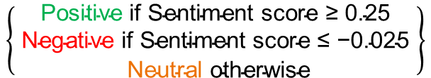
Methodology
Sentence score- Lexicon based approach
Total score = ( -0.1+ 0 + 0.125 + 0 + 0 + 0.375 )
= 0.4
Total score is normalized between ( -1 to 1) using hyperbolic tangent (tanh) function
Sentiment score = tanh(0.4)
= 0.379
Sentence is classified to either of label using following calculation.
$$\left\{\begin{aligned}\text{Positive} \text{if} \text{Sentiment} \text{s}\text{core}\text{ ≥ 0.25} \\ \text{Negative} \text{if} \text{Sentiment} \text{s}\text{core}\text{ ≤ −0.025 } \\ \text{Neutral} \text{otherwise}\end{aligned}\right\}$$
Sentiment score of the given sentence is > 0.25, so it is Positive
Fig.02: Workflow of Lexicon based approach

Slide 30
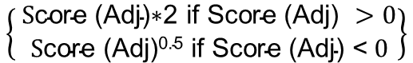
Methodology
Fuzzy Logic- Lexicon based approach
The adverbs such as not, never and very, highly either reverse or magnifies the polarity.
Case 1 : There are few adverbs like very, really, extremely etc., which may be used positively or negatively like very good, very bad etc. To handle it, following logic is utilized.
$$\left\{ \begin{aligned}\text{S}\text{core}\text{ (}\text{Adj}\text{)∗2 }\text{if} \text{S}\text{core}\text{ (}\text{Adj}\text{) }>0 \\ \text{S}\text{core}\text{ (}\text{Adj}\text{)0.5 }\text{if} \text{Score}\text{ (}\text{Adj}\text{) }\text{<} 0\end{aligned}\right\}$$
Adjusted score =
Score (bad) = -0.642
Score (very bad) = (-0.642)^{0.5} = -0.801
Score (good) = 0.619
Score (very good) = (0.619)*2 = 1.238
Fig.02: Workflow of Lexicon based approach

Slide 31
Methodology
Fuzzy Logic- Lexicon based approach
The adverbs such as not, never and very, highly either reverse or magnifies the polarity.
Case 2 : Negation words such as ”never” and ”not” reverse the orientation. For example, the phrase ”not good” may signify ”bad.” When such negation words are detected, the Positivity and Negativity scores of the corresponding word are swapped.
Score (bad) = ( Pos: 0, Neg : 0.642, Score: -0.642 )
Score (not bad) = ( Pos: 0 , Neg : 0.642, Score: -0.642 )
Score (not bad) = ( Pos: 0.642 , Neg : 0, Score: 0.642 )
Fig.02: Workflow of Lexicon based approach

Slide 32
Methodology
Fuzzy Logic- Lexicon based approach
The adverbs such as not, never and very, highly either reverse or magnifies the polarity.
Case 3 : When Case 1 and Case 2 may appear together like “not very good” .
Score = (A × B)^{0.5}
Where,
A = very/extremely/highly etc. (Adj)
B = not/never etc. (Adj)
Fig.02: Workflow of Lexicon based approach

Slide 33
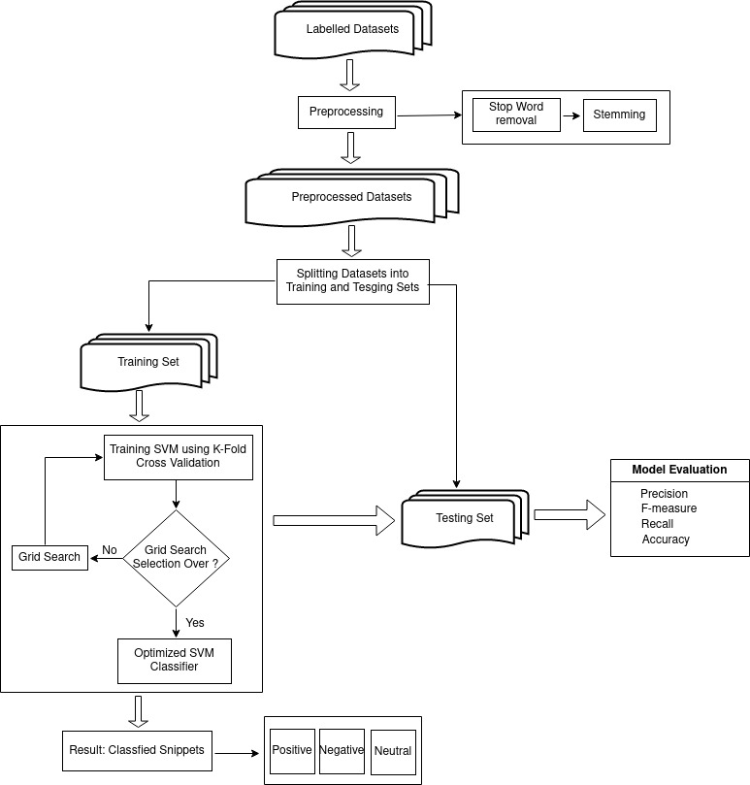
Methodology
Methodology for SVM
Sentence that cannot be classified by Lexicon based.
It is confirmed that the machine operates continuously until the task is finished.
The dinner wasn’t what we expected.
The store was out of bread.
Classified snippets from first method is used as dataset.
To enable variety of sentence, amazon review dataset is also utilized.
Further pre-processing
Stop Word : a, an, the, I, you, he, she, we, they etc.
Stemming :
Such an analysis can reveal features that are not easily visible.
Such an analysi can reveal featur that ar not eas visibl.
Training (k = 5 Folds) and testing
Classification (Positive,Negative,Neutral)
Fig.03: Methodology for SVM

Slide 34
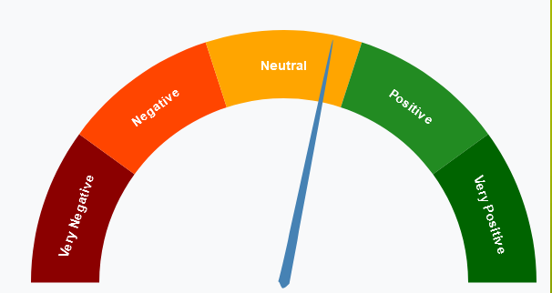
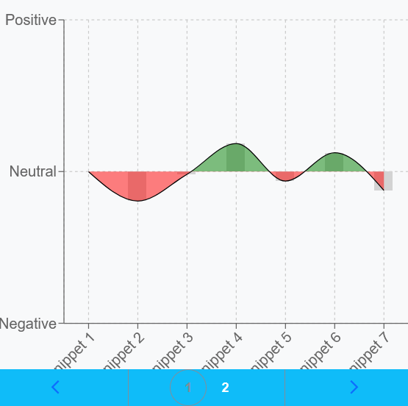
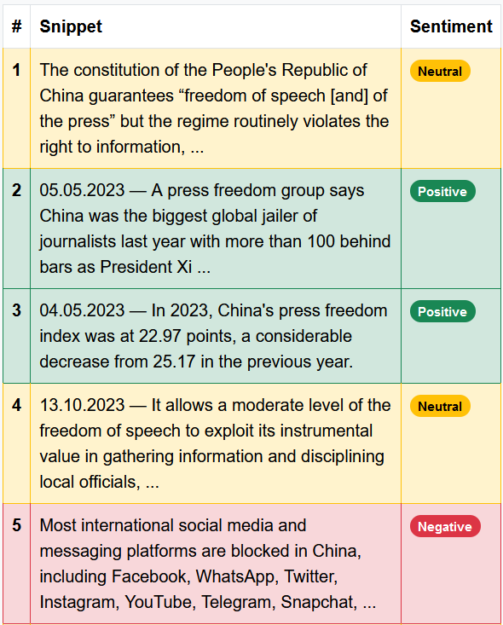
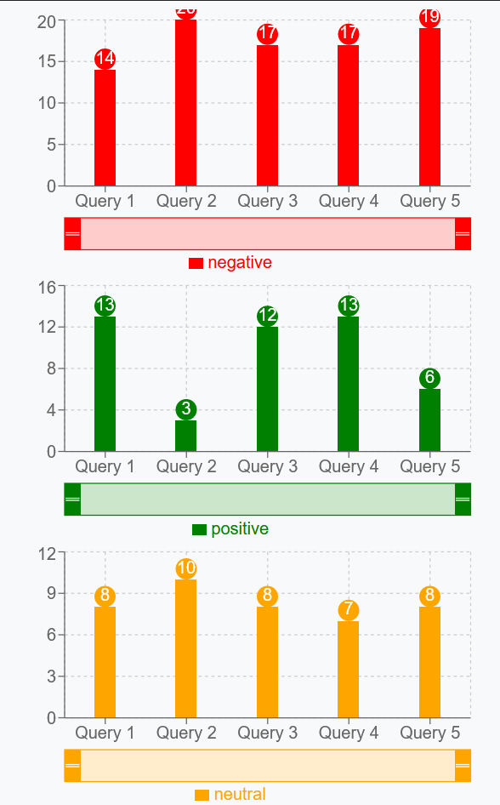
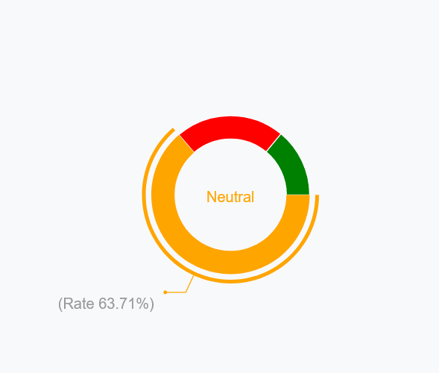
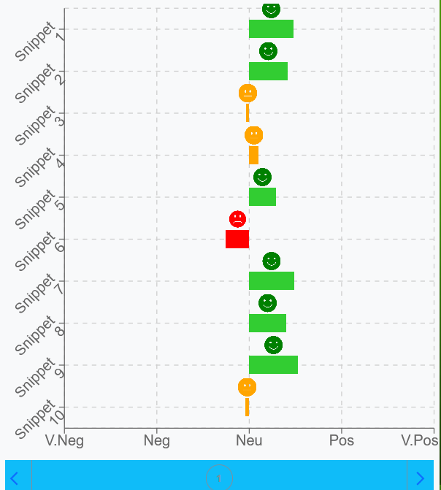
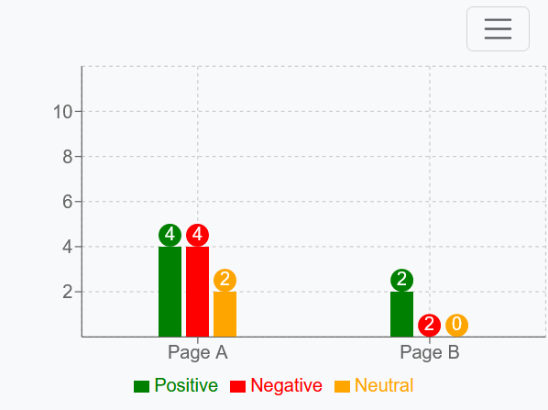
Methodology
Visualization Elements
Fig.04: Sentiment meter
Fig.05: Area diagram
Fig.06: Sentiment classification
Fig.07: Pie chart
Fig.09: Bar diagram
Fig.08: Horizontal bar diagram
Fig.10: Bar diagram

Slide 35
Outline
Introduction
Background
Research Objectives
Implementation
Backend
Frontend and Visualization
Methodology
Evaluation
Result and Analysis
Conclusion and Future Works

Slide 36
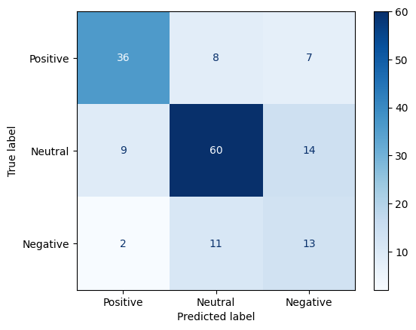
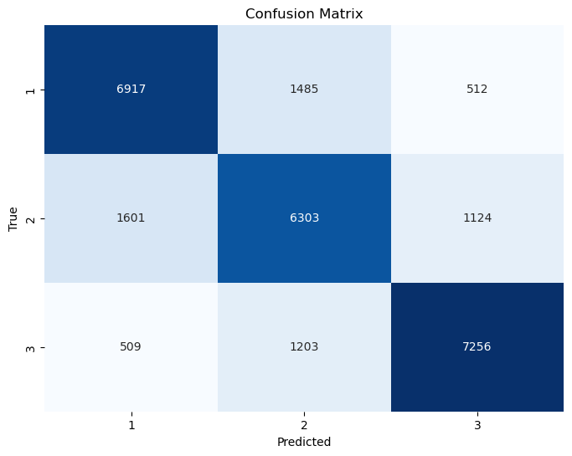
Evaluation
Evaluation – Lexicon based
Evaluation – SVM
Confusion matrix
Confusion matrix
Accuracy: 68%
Precision: 70%
Recall: 68%
F1-score: 68%
Accuracy: 77%
Precision: 76%
Recall: 76%
F1-score: 76%

Slide 37
Outline
Introduction
Background
Research Objectives
Implementation
Backend
Frontend and Visualization
Methodology
Evaluation
Result and Analysis
Conclusion and Future Works

Slide 38
Result and Analysis
Research Question - 1
Does the sentiment tone of result snippets from different search engines for the same query vary from each other?
For the Query ”Morality of Genetics Manipulation”, results were scraped up to 20th position.
We can see variations in sentiment tone, Google and DuckDuckGo have more numbers of positive results whereas Bing has least number of positive results and more neutral results.
Search Engine | Total results | Positive | Negative | Neutral
Google | 18 | 9 | 5 | 4
Bing | 10 | 2 | 3 | 5
DuckDuckGo | 20 | 13 | 3 | 4
Table.01: Distribution of sentiments

Slide 39
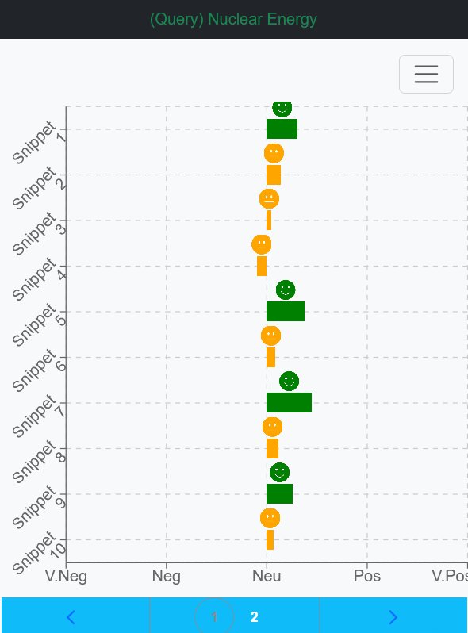
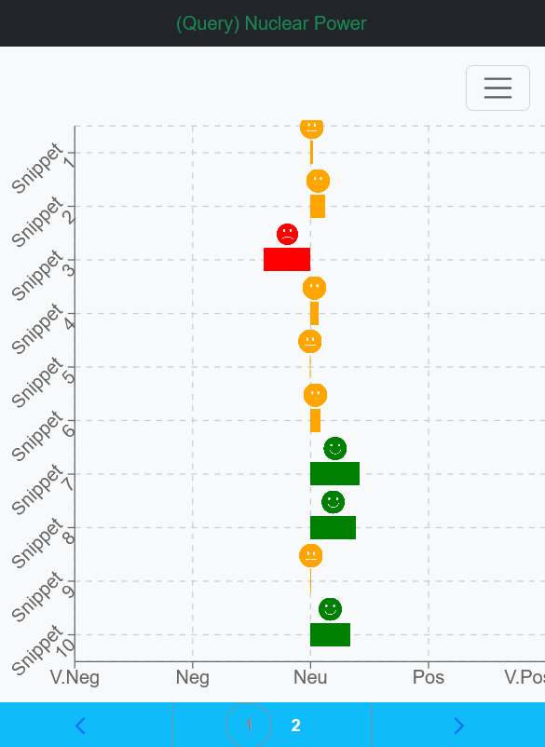
Result and Analysis
Research Question - 2
Do search results and their sentiment differ with the use of synonyms or phrases?
To find the difference, two queries ”Nuclear Energy” and ”Nuclear Power”, results were collected up to 20th position.(Google)
First 10 results for ”Nuclear Energy ”, snippets are classified into either positive or neutral, none are negative. For ”Nuclear Power” for first 10 results, almost half are neutral, 3 positive and 1 negative sentiment.
Fig.11: Sentiment level of snippets for query 1
Fig.12: Sentiment level of snippets for query 2

Slide 40
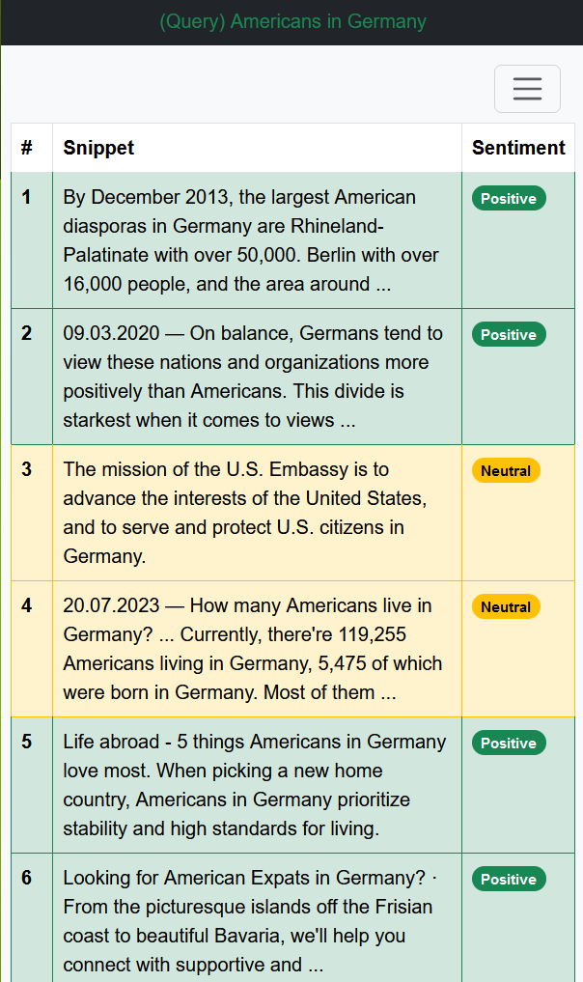
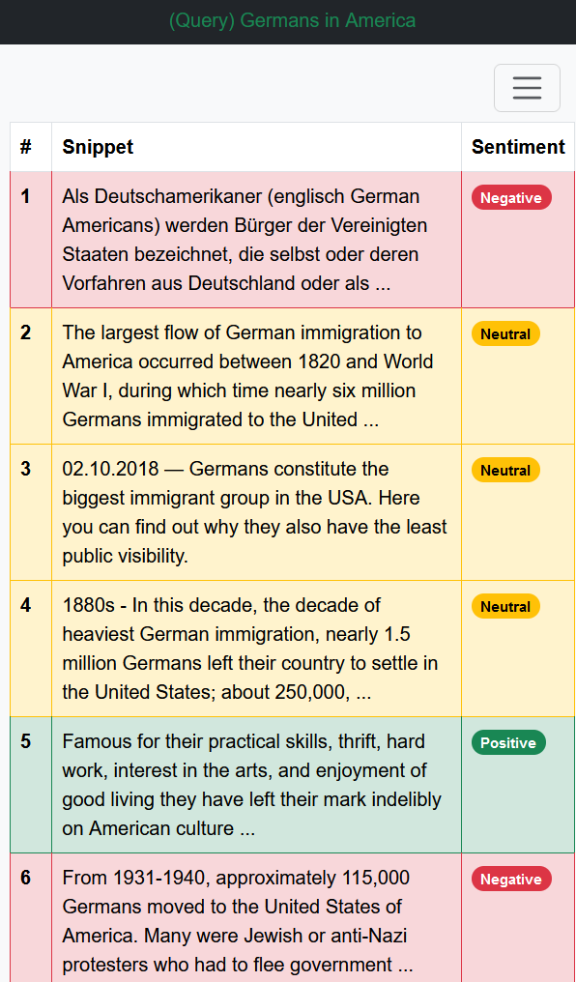
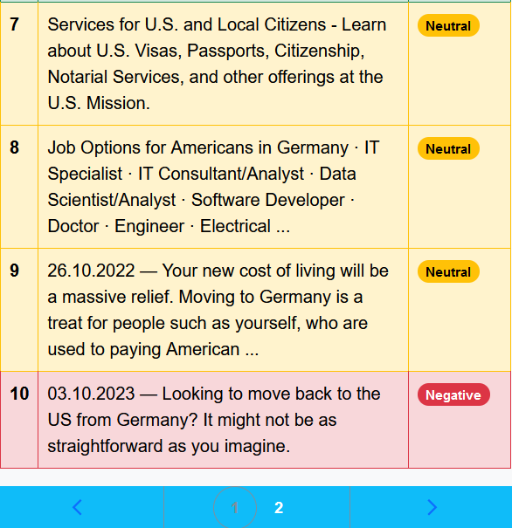
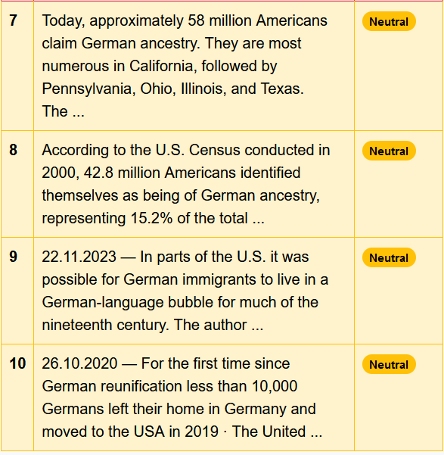
Result and Analysis
Research Question - 3
Do search engines unknowingly or privately support or discriminate based on race, religion, ethnicity, geography, etc?
Comparison between ”Americans in Germany” and ”Germans in America.” For both queries, sentiment of the top 10 results was analyzed.
” Americans in Germany” has more positive sentiment distribution. Results focused on positive aspects of American life in Germany, cultural exchange, and social integration. For ”Germans in America (8 out of 10) were neutral, with one negative and one positive. The search results emphasized the experiences of war-related content and German immigrants.
Fig.13: Sentiment classification for query 1
Fig.13: Sentiment classification for query 2

Slide 41
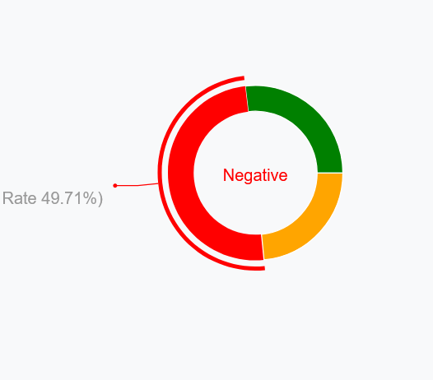
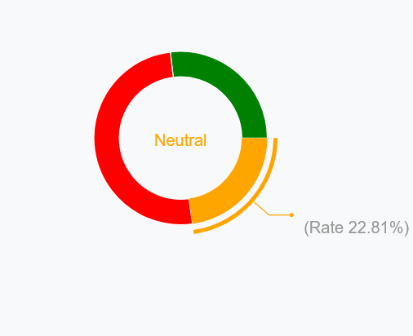
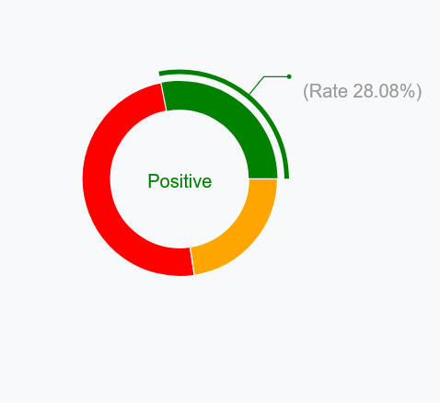
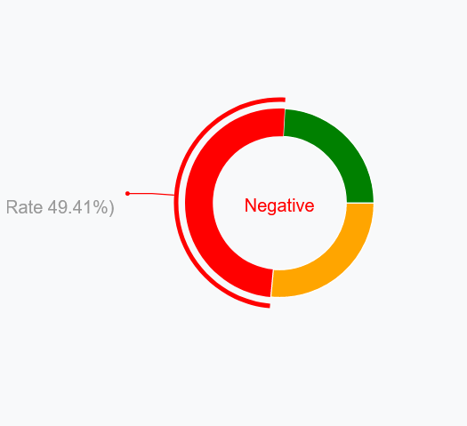
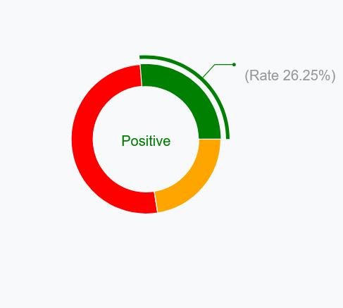
Result and Analysis
Research Question - 4
What is the sentiment distribution for the query or set of (controversial) queries, how the distribution changes with further positions ?
Sentiments for the top 40 results for 5 controversial queries.(google)
”Ukraine crisis”
”Russo-Ukrainian War”
”Ukrainian military intervention in Russia”
”Invasion of Ukraine”
”Russian military intervention in Ukraine”
What is overall distribution of sentiments, how it changes when position is changed ?
Sentiment distribution 1st place
Sentiment distribution 2nd place
Sentiment distribution 3rd place
Positive: 26.86%
Negative: 49.71%
Neutral: 23.43%
Positive: 26.90%
Negative: 50.29%
Neutral: 22.81%
Positive: 28.08%
Negative: 49.32%
Neutral: 22.60%
Sentiment distribution 4th place
Sentiment distribution 5th place
Positive: 24.12%
Negative: 49.41%
Neutral: 26.47%
Positive: 26.25%
Negative: 51.25%
Neutral: 22.50%

Slide 42
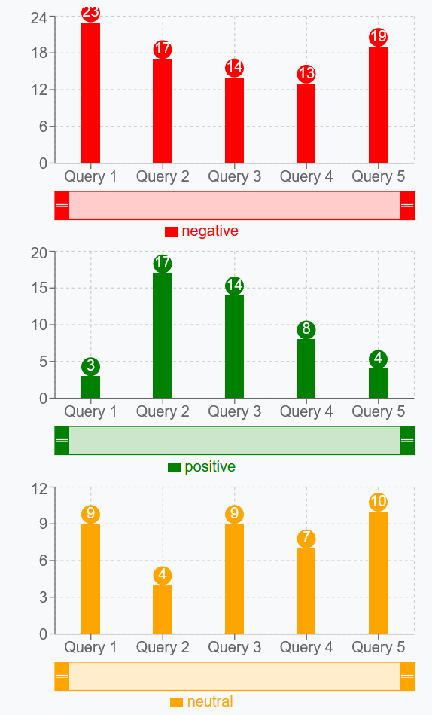
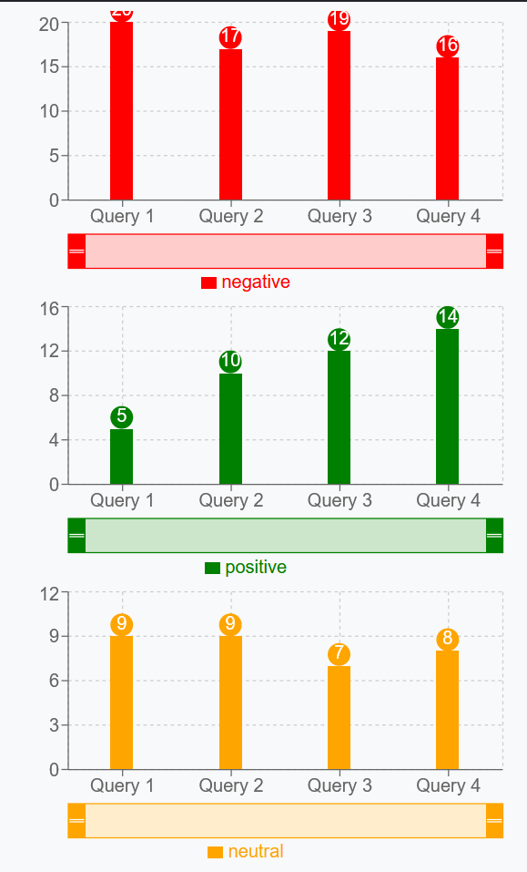
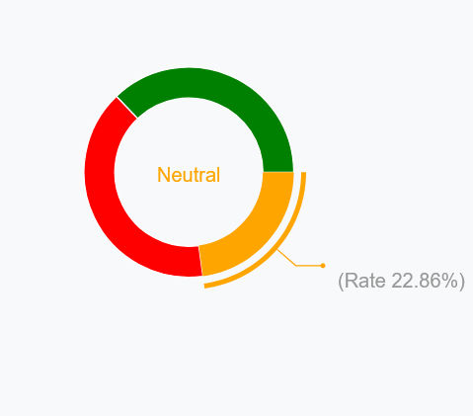
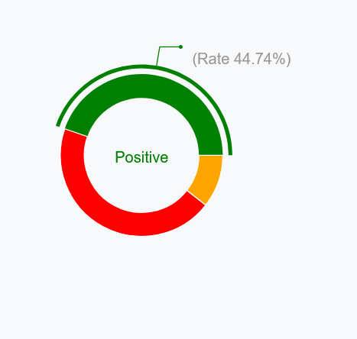
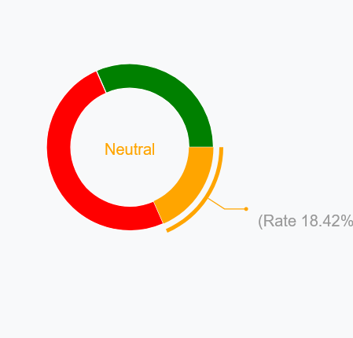
Result and Analysis
Research Question - 4
What is the sentiment distribution for the query or set of (controversial) queries, how the distribution changes with further positions ?
Sentiments for the top 40 results for 5 controversial queries.(google)
”Ukraine crisis”
”Russo-Ukrainian War”
”Ukrainian military intervention in Russia”
”Invasion of Ukraine”
”Russian military intervention in Ukraine”
What is sentiment distribution only for the query ”Ukraine crisis” at each position?
Sentiment distribution 1st place
Sentiment distribution 2nd place
Sentiment distribution 3rd place
Positive: 37.14%
Negative: 40%
Neutral: 22.86%
Positive: 44.44%
Negative: 44.74%
Neutral: 10.53%
Positive: 31.58%
Negative: 50%
Neutral: 18.42%

Slide 43
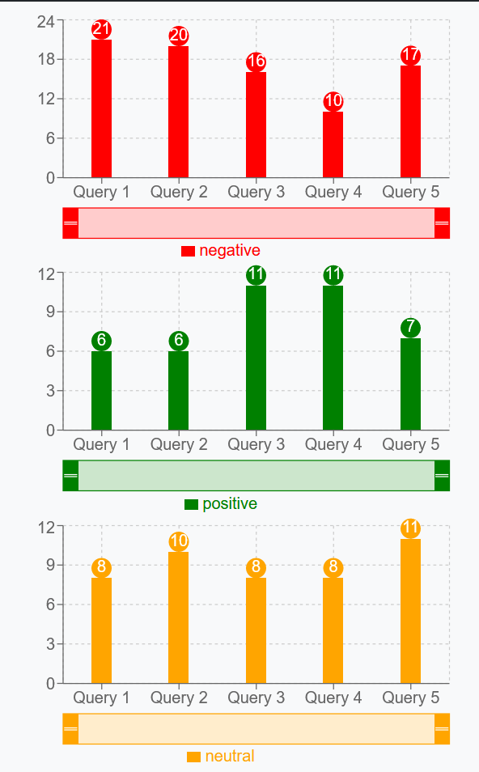
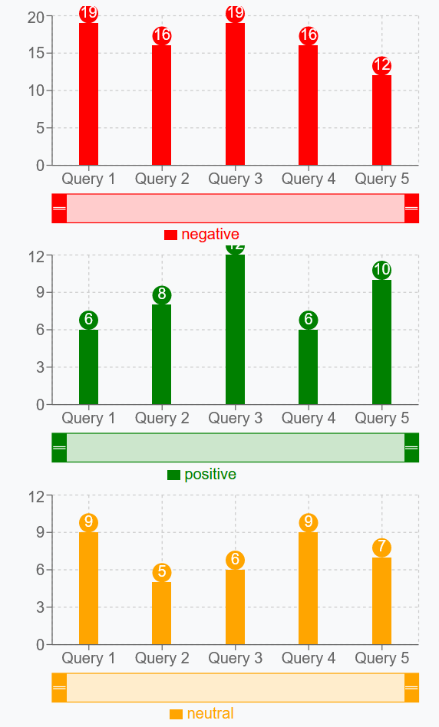
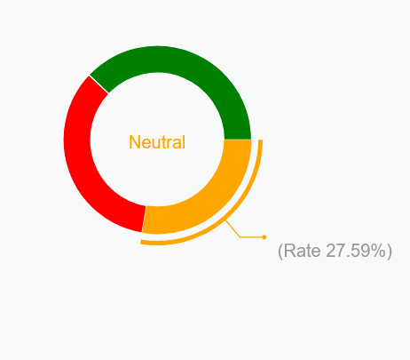
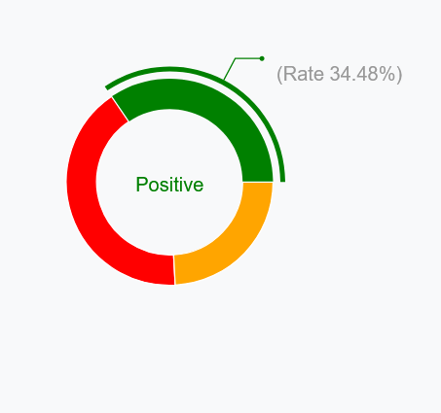
Result and Analysis
Research Question - 4
What is the sentiment distribution for the query or set of (controversial) queries, how the distribution changes with further positions?
Sentiments for the top 40 results for 5 controversial queries.(google)
”Ukraine crisis”
”Russo-Ukrainian War”
”Ukrainian military intervention in Russia”
”Invasion of Ukraine”
”Russian military intervention in Ukraine”
What is sentiment distribution only for the query ”Ukraine crisis” at each position?
Sentiment distribution 4th place
Sentiment distribution 5th place
Positive: 37.93%
Negative: 34.48%
Neutral: 27.59%
Positive: 34.48%
Negative: 41.38%
Neutral: 24.14%

Slide 44
Outline
Introduction
Background
Research Objectives
Implementation
Backend
Frontend and Visualization
Methodology
Evaluation
Result and Analysis
Conclusion and Future Works

Slide 45
Conclusion and Future Works
Conclusion
A sentiment analysis and visualization system is developed, that scrapes results, performs sentiment analysis and visualize the findings. Needs more improvement on lexicon-based approach.
Sentiment analysis is Powerful tool to understand the sentiments tone on Result snippets.
Visualization makes it more easy to understand and analyze the sentiments.
Other possible uses :
Filter results
Different information (reviews, opinions etc.), assist in decision making.
Find and analyze brand value, reputation, and public opinions.
Sentiment based recommendation and filtering, improve ranking of results by analyzing user preferences.

Slide 46
Conclusion and Future Works
Future Works
Exploring advanced natural language processing techniques
Including multiple languages
Expanding to multiple Search engines
Implementing more Visualization techniques and user customization

Slide 47

Conclusion and Future Works
Future Works
Exploring advanced natural language processing techniques
Including multiple languages
Expanding to multiple Search engines
Implementing more Visualization techniques and user customization
Source: https://www.gettyimages.de/

Slide 48
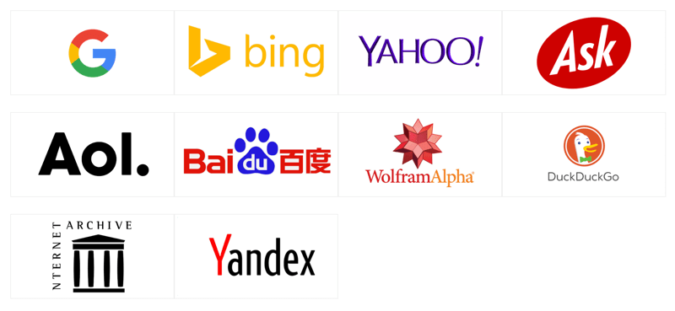
Conclusion and Future Works
Future Works
Exploring advanced natural language processing techniques
Including multiple languages
Expanding to multiple Search engines
Implementing more Visualization techniques and user customization

Slide 49
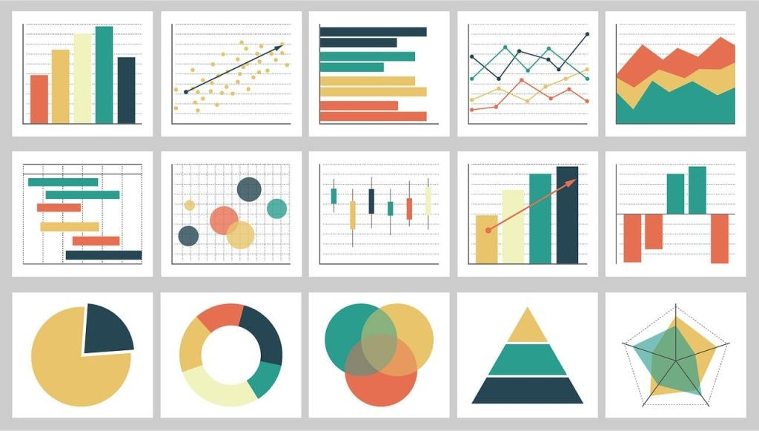
Conclusion and Future Works
Future Works
Exploring advanced natural language processing techniques
Including multiple languages
Expanding to multiple Search engines
Implementing more Visualization techniques and user customization
Source: https://shorturl.at/agvY7

Slide 50
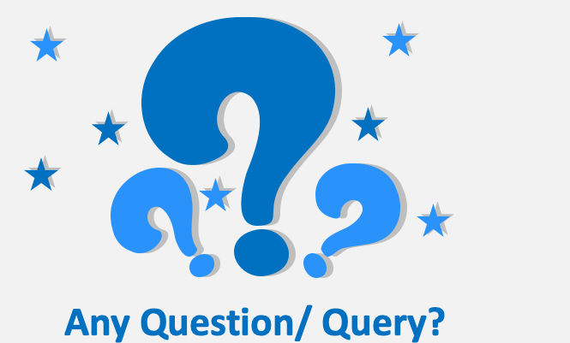
Thank you for your attention !

